Slide 1
Pivot Tables &
Summarization

Slide 2

Explore Pivot Table!!!
A pivot table is a powerful tool in data analysis, commonly used in spreadsheet programs like Microsoft Excel and Google Sheets. It allows you to summarize, organize, and analyze large datasets by transforming rows and columns of data into meaningful summaries. You can use a pivot table to calculate totals, averages, counts, or other aggregations across different categories, making it easier to identify patterns and insights.

Slide 3
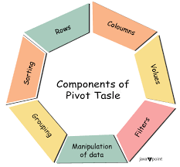
Key Components of a Pivot Table
★ Rows and Columns:
You can organize your data by dragging and dropping fields into the Rows and Columns areas of the Pivot Table.
★ Values:
The Values area allows you to perform calculations on your data, such as sum, count, average, etc.
★ Filters:
Filters help you narrow down the data displayed in the Pivot Table based on specific criteria.
★ Values:
This is where the numeric data or metrics go. The Values area usually contains aggregated fields, such as sums, averages, counts, etc.

Slide 4

Advantages of Pivot Tables
Quick Data Summarization
Easy to Use
Data Filtering and Sorting
Flexible Data Analysis
Improved Data Organization
Data Visualization Compatibility
Time-Saving
Data Exploration
Error Minimization
Data Consistency

Slide 5

Steps to Create a Pivot Table in Excel
Select Your Data:
Highlight the data range you want to analyze. Make sure your data is organized into columns with headers
(e.g., “Product,” “Sales,” “Region,” etc.).
Insert a Pivot Table:
Go to the Insert tab.
Click PivotTable.
In the dialog box, select the data range, and choose where you want the pivot table to be placed (either in a new worksheet or an existing one).

Slide 6
Organize Fields:
Rows: Drag a field
(e.g., “Product”) to the Rows area. This will list the unique values from that field.
Columns: Drag a field
(e.g., “Region”) to the Columns area to create column headers.
Values: Drag a field
(e.g., “Sales”) to the Values area. Excel will automatically sum the values, but you can change this to other functions like Average, Count, etc.
Filters: Drag a field to the
Filters area: If you want to filter the table based on certain criteria (e.g., filter by year or product type),
Customize the Table:
You can modify how the data is summarized, format the results, and apply filters or sorting to make the data more meaningful.

Slide 7
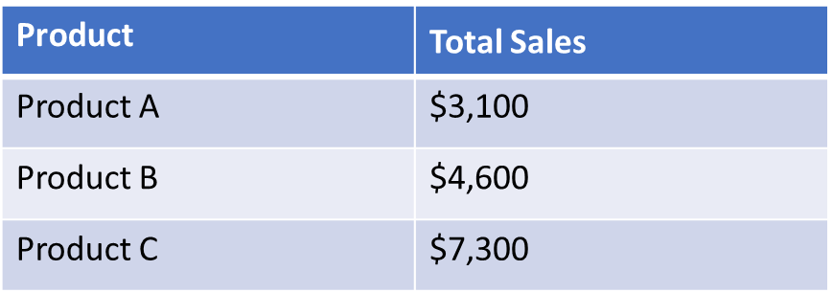
Pivot table summarization
Pivot table summarization refers to the process of condensing large datasets into meaningful, aggregated insights using a pivot table. By organizing and summarizing data based on selected fields (such as rows, columns, values, and filters), you can quickly identify patterns, trends, and outliers in your data
Summing Data
Example: You can sum sales data by product, region, or salesperson to get total sales figures.
Use Case: Summarizing total revenue by product or region over a certain time period.

Slide 8

Conclusion
In conclusion, pivot tables are an essential tool for data analysis and reporting, offering a flexible, efficient, and intuitive way to summarize and visualize large datasets. They allow users to quickly aggregate, filter, and analyze data across multiple dimensions (e.g., by product, region, or time period) without complex formulas or manual work. With pivot tables, you can derive meaningful insights, such as identifying trends, comparing performance, or discovering patterns, all in a dynamic format that updates automatically as your data changes.

Slide 9

Thank you !!!
ajaycraju98@gmail.com

